Slide 1
Predication CI/CD

Slide 2
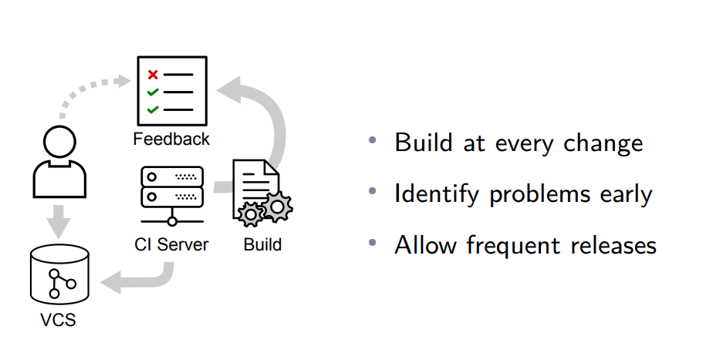
Continues Integration Process

Slide 3
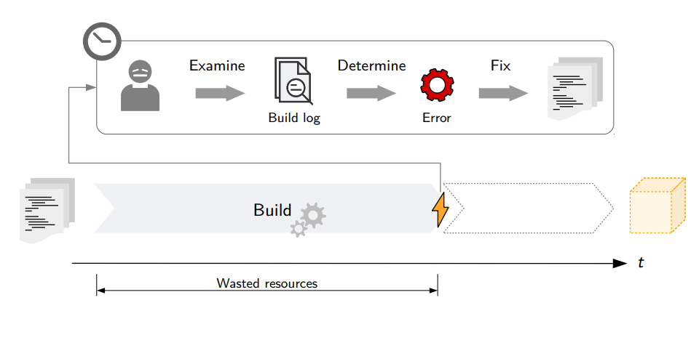
Build Failure
Reason for Defect
Complex code
Bad Practice
Unstable Environment

Slide 4
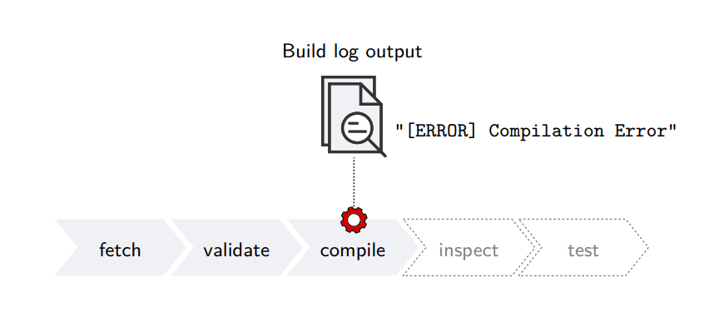
Analysis
Which errors cause CI build failures?
What factors influence build outcomes?
Can we predict build failures?

